Slide 1
Car Damage Prediction Project
Leveraging Deep Learning for Automated Damage Classification
Presented by: Neethu Manikantan

Slide 2
Project Overview & Objective
To develop and train a robust deep learning model capable of accurately classifying various types of car damage from images.
Aim to streamline the damage assessment process for insurance claims or repair estimations.

Slide 3
Key Libraries Used
PyTorch: Core deep learning framework for tensor computation, neural networks, and automatic differentiation.
TorchVision: For datasets, models (pre-trained ResNet), and image transformations (data augmentation, preprocessing).
NumPy: Numerical operations, especially for handling arrays and matrices (e.g., in confusion matrix calculations).
Matplotlib: Data visualization (plotting loss/accuracy curves, confusion matrix).
Optuna: For efficient hyperparameter optimization.

Slide 4
Dataset and Preprocessing
Dataset Size: 2300 images across 6 distinct damage classes.
Data Splitting:
Training Set: 75% of data (1725 images)
Validation Set: 25% of data (575 images)
Image Transformations (Data Augmentation & Standardization):
RandomHorizontalFlip(): Enhances generalization.
RandomRotation(10): Introduces rotational invariance.
ColorJitter(brightness=0.2, contrast=0.2): Simulates varying lighting conditions.
Resize((224, 224)): Standardizes input dimensions for the CNN.
ToTensor(): Converts images to PyTorch tensors, scaling pixel values [0,1].
Normalize(mean=[0.485, 0.456, 0.406], std=[0.229, 0.224, 0.225]): Standardizes pixel values using ImageNet statistics, critical for pre-trained models.
Data Loaders: DataLoader objects are used for efficient batching (batch size 32), shuffling (training), and multi-process data loading.

Slide 5
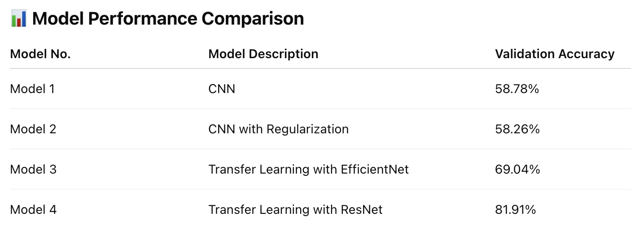
Model Training

Slide 6
Final Model
Base Model: ResNet50 (Residual Network 50-layer)
Utilized a pre-trained ResNet50 model from torchvision.models.
Transfer Learning: Leveraging features learned from the vast ImageNet dataset to improve performance on our specific car damage dataset.
Acts as a powerful feature extractor.
Custom Classifier Head:
The original final fully connected layer (fc) of ResNet50 was replaced.
A new nn.Linear layer was added to map the extracted features to the 6 specific car damage classes.

Slide 7
Deployment Architecture (Streamlit & FastAPI)
Frontend (app.py - Streamlit):
User-friendly web interface for uploading car images.
Displays uploaded image and prediction result.
Sends image data to the backend via an API call.
Backend (model_helper.py & FastAPI Server):
model_helper.py contains the core inference logic.
A FastAPI server (implied by app.py's API call) hosts the prediction endpoint (/predict).
Loads the trained ResNet50 model (lazy loading).
Performs image preprocessing and classification.
Returns the predicted damage class to the frontend.
Interaction: Streamlit client makes HTTP POST requests to the FastAPI server for real-time predictions.

Slide 8
Conclusion
Successfully developed and deployed a deep learning model for automated car damage classification.
Leveraged pre-trained ResNet50, extensive data augmentation, and optimized training.
Achieved a functional prototype with a Streamlit frontend and FastAPI backend.

Slide 9
THANK YOU

